Slide 1
Data Preprocessing
Machine Learning Practice
Debajyoti Biswas
SNU Chennai

Slide 2
The real world training data is usually not clean and has many issues such as missing values for certain features, features on different scales, non-numeric attributes etc.
Often there is a need to pre-process the data to make it amenable for training the model.
Sklearn provides a rich set of transformers for this job.
The same pre-processing should be applied to both training and test set.
Sklearn provides pipeline for making it easier to chain
multiple transforms together and apply them uniformly across train, eval and test sets.

Slide 3
Once you get the training data, the ﬁrst job is to explore the data and list down preprocessing needed.
Typical problems include
Missing values in features
Numerical features are not on the same scale.
Categorical attributes need to be represented
with sensible numerical representation.
Too many features, reduce them.
Extract features from non-numeric data.

Slide 4
Sklearn provides a library of transformers for data preprocessing.
Data cleaning (sklearn.preprocessing) such as
standardization, missing value imputation, etc. Feature extraction (sklearn.feature_extraction) Feature reduction (sklearn.decomposition.pca) Feature expansion (sklearn.kernel_approximation)

Slide 5
Transformer methods
Each transformer has the following methods:
fit() method learns model parameters from a training
set.
transform() method applies the learnt transformation
to the new data.
fit_transform() performs function of both fit() and
transform() methods and is more convenient and efﬁcient to use.

Slide 6
Part 1. Feature extraction

Slide 7
sklearn.feature_extraction has useful APIs to extract features from data:
DictVectorizer
FeatureHasher
Let's study these APIs one by one.

Slide 8
DictVectorizer
Converts lists of mappings of feature name and feature
value, into a matrix.
Transformed feature matrix X′
Original data
data =
[{'age': 4, 'height':96.0},
{'age': 1, 'height':73.9},
{'age': 3, 'height':88.9},
{'age': 2, 'height':81.6}]
⎡
4 96.0
1 73.9
3 88.9
2 81.6
⎤
X
′
=
⎢
⎥
4×2
⎢
⎥
⎣
⎦
dv = DictVectorizer(sparse=False) dv.fit_transform(data)

Slide 9
Part 2: Data Cleaning

Slide 10
Handling missing values

Slide 11
Missing values occur due to errors in data capture such as sensor malfunctioning, measurement errors etc.
Many ML algorithms do not work with missing data and need all features to be present.
Discarding records containing missing values would result in loss of valuable training samples.
sklearn.impute API provides functionality to ﬁll missing
values in a dataset.
SimpleImputer
KNNImputer
MissingIndicator
provides indicators for missing values.

Slide 12
SimpleImputer
Fills missing values with one of the following strategies:
'mean', 'median', 'most_frequent' and 'constant'.
Original feature matrix X
Transformed feature matrix X′
si = SimpleImputer(strategy='mean') si.fit_transform(X)
⎡ 7 1
nan 8
⎤ ⎡⁷
1⎤
⎥⎥
⎦
8⎥
X =
⎢
X′ 4×2 = ^{⎢6}
4×2
⎢
2 nan
9 6
2 5
⎣
⎣
9 6
⎦
7 + 2 + 9 ₌3
6
3
1 + 8 + 6 ₌ ₅

Slide 13
KNNImputer
Uses k-nearest neighbours approach to ﬁll missing values in a dataset.
The missing value of an attribute in a speciﬁc example is ﬁlled with the mean value of the same attribute of n_neighbors closest neighbors.
The nearest neighbours are decided based on Euclidean distance.

Slide 14
Example: KNNImputer
Consider following feature matrix.
⎡ 1. 2. nan
3. 4. 3.
nan 6. 5.
8. 8. 7.
X =
⎢
⎥
4×3
⎢
⎥
⎣
⎦
It has 4 samples and 2 missing values.
Let's ﬁll in missing values with KNNImputer.

Slide 15
Computing Euclidean distance in presence of missing values
dist(x, y) = weight × distance from present coordinates²
_{weight =} total number of coordinates number of present coordinates
For example, the distance between x = [3, nan, nan, 6] and
y = [1, nan, 4, 5] is:
_{weight =} total number of coordinates
= ⁴ = 2
number of present coordinates 2
distance from present coordinates² = (3 − 1)² + (6 − 5)² = 5
dist(x, y) = 2 × 5 ≈ 3.3

Slide 16
⎡ 1. 2. nan⎤
Let's ﬁll the missing value in ﬁrst sample/row. _{X4×3 =} ⎢ ^{3.}
4. 3.
⎥
nan 6. 5.
8. 8. 7.
⎣
⎦
X=[[3, 2, 1],[np.nan, 2,5],[2,4,5]]
Distance with [1. 2. nan.]
[3. 4. 3.]
³ ((1 − 3)² + (2 − 4)²) ≈ 3.46
2 nearest neighbours
2
[nan 6. 5.]
³ (2 − 6)² ≈ 6.92
1
[8. 8. 7.]
³ ((1 − 8)² + (2 − 8)²) ≈ 11.29
2
Values of the feature from
2 nearest neighbours
3 + 5 ₌ ₄
[1. 2. 4.]
2
# of neighbours

Slide 17
In this way, we can ﬁll up the missing values with KNNImputer.
Original feature
matrix X
Transformed feature
matrix X′
⎡ 1. 2. nan.⎤
⎡ 1. 2. 4.⎤
_{= ⎢} 3. 4. 3. ⎥
4. 3.⎥
X
⎢
⎥
X′ 4×4 = ^{⎢ 3.}
5.5 6. 5.
4×4
nan 6. 5.
8. 8. 7.
⎣
⎦
⎣
8. 8. 7.
⎦
knni = KNNImputer(n_neighbors=2, weights="uniform") knni.fit_transform(X)

Slide 18
Marking imputed values
It is useful to indicate the presence of missing values in the dataset.
MissingIndicator helps us get those indications.
It returns a binary matrix,
True values correspond to missing entries in original dataset.

Slide 19
1.2 Numeric transformers
Feature scaling
Polynomial transformation
Discretization

Slide 20
Feature scaling
Numerical features with different scales leads to slower convergence of iterative optimization procedures.
It is a good practice to scale numerical features so that all of them are on the same scale.
Let's learn how to scale numerical features with sklearn API.
Three feature scaling APIs are available in sklearn
StandardScaler
MaxAbsScaler
MinMaxScaler

Slide 21
StandardScaler
Transforms the original features vector x into new feature
vector x′ using following formula
x − μ
Learns parameters μ
and σ.
_{x}′
=
σ
4
⎡
0
⎤
3
−1/ 2
= −2/ 2
1/ 2
2/ 2
⎢ ⎥
⎢
⎥
x_{5×1} = ⎢2⎥
ss = StandardScalar() ss.fit_transform(x)
x
′
⎢
⎥
⎦
5×1
5
⎣ ⎦
⎣
6
μ = 4, σ = 2
μ′ = 0, σ′ = 1
Note that the transformed feature vector x′ has
mean (μ) = 0 and standard deviation (σ) = 1.

Slide 22
MinMaxScaler
It transforms the original feature vector x into new feature vector x′ so that all values fall within range [0, 1]
_{x′ =} x − x.min
x.max − x.min
where x.max and x.min are largest and smallest values of that feature respectively, of the original feature vector x.
15
2
5
−2
−5
⎡ ¹ ⎤
⎢
⎥
mms = MinMaxScalar() mms.fit_transform(x)
⎢
0.35
⎥
x =
⎢
⎣
⎥
⎦
x
′
=
⎢
⎣
0.5
0.6
0
⎥
⎦
5×1
5×1
x.max = 15, x.min = -5
The largest number is transformed to 1 and
the smallest number is transformed to 0.

Slide 23
MaxAbsScaler
It transforms the original features vector x into new feature vector x′ so that all values fall within range [−1, 1]
_{x′ =} x
MaxAbsoluteValue
where MaxAbsoluteValue = max(x.max, ∣x.min∣)
4
2
5
−2
−100
⎡ 0.04 ⎤
⎡⎢
⎤⎥
⎢ 0.02 ⎥
mas = MaxAbsScalar() mas.fit_transform(x)
_{x}′
_{5×1} = ⎢ 0.05 ⎥
x5×1 = ⎢
⎥
−0.02
⎣
⎦
⎣ ⎦
−1
MaxAbsoluteValue = max(5, ∣ − 100∣) = 100

Slide 24
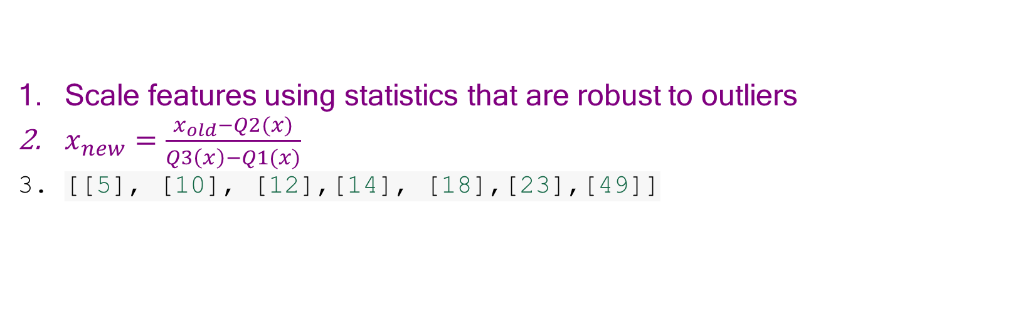
RobustScaler()
Scale features using statistics that are robust to outliers
$x_{new}=\frac{x_{old}−Q2(x)}{Q3\left(x\right)−Q1(x)}$
[[5], [10], [12],[14], [18],[23],[49]]

Slide 25
FunctionTransformer
Constructs transformed features by applying a user deﬁned function.
⎡128 2
⎤ ⎡⁷
1⎤
2 256
4 1
512 64
⎥⎥
⎦
8⎥
X =
⎢
X′ 4×2 = ^{⎢1}
4×2
⎢
2 0
⎣
⎣
9 6
⎦
ft = FunctionTransformer(numpy.log2) ft.fit_transform(X)
Applies log₂ function to the features.

Slide 26
KBinsDiscretizer
Divides a continuous variable into bins.
One hot encoding or ordinal encoding is further applied to the bin labels.
⎡⎢
0
0.125
0.25
0.375
0.5
0.675
0.75
0.875
1.0
⎤⎥
⎡0.⎤
0.
⎢ ⎥
⎢
⎥
KBinsDiscretizer( n_bins=5, strategy='uniform', encode = 'ordinal')
⎢ ⎥
1.
⎢ ⎥
1.
x =
⎢
⎥
x
′
⎢ ⎥
9×1
9×1
= 2.
⎢
⎣
⎥
⎦
⎢3.⎥
⎢3.⎥
4.
⎣ ⎦
4.

Slide 27
1.2 Categorical transformers
Feature encoding
Label encoding

Slide 28
OneHotEncoder
Encodes categorical feature or label as a one-hot numeric array.
Creates one binary column for each of K unique values.
Exactly one column has 1 in it and rest have 0.
⎡¹⎤
⎡1 0 0
0 1 0
0 0 1
1 0 0
ohe=OneHotEncoder() ohe.fit_transform(x)
_{X}′
⎢
⎥
x4×1 = ^{⎢2⎥}
4×3
=
⎢
⎥
3
⎣ ⎦
⎣
⎦
1
# unique values:
K = 3
# columns in transformed matrix = 3
[‘Batman’,’Superman’,’Wonderwoman’,’spiderman’ ]

Slide 29
LabelEncoder
Encodes target labels with value between 0 and K − 1, where
K is number of distinct values.
1
⎡⁰⎤
2
⎢ ⎥
⎢¹⎥
6
le = LabelEncoder() le.fit_transform(y)
_{y}′
2
y =
⎢ ⎥
=
⎢ ⎥
6×1
1
6×1
⎢ ⎥
0
8
3
⎣ ⎦
⎣ ⎦
6
2
Here K = 4: {1, 2, 6, 8}
1 is encoded as 0, 2 as 1, 6 as 2, and 8 as 3.

Slide 30
OrdinalEncoder
Encodes categorical features with value between 0 and
K − 1, where K is number of distinct values.
⎡1 ‘male′
⎤
⎡0 1⎤
2 ‘female
′
1 0
⎢
⎥
⎢
6 ‘female′
1 ‘male′
8 ‘male′
6 ‘female′
⎥
oe = OrdinalEncoder() oe.fit_transform(X)
_{X}′
⎢
2 0
0 1
3 1
2 0
⎥
X =
⎢
⎣
=
⎥
⎦ ⎣
6×2
6×2
⎢
⎥
⎢
⎥
⎦
OrdinalEncoder can operate multi dimensional data, while LabelEncoder can transform only 1D data.

Slide 31
LabelBinarizer
Several regression and binary classiﬁcation can be extended to multi-class setup in one-vs-all fashion.
This involves training a single regressor or classiﬁer per class.
For this, we need to convert multi-class labels to binary labels, and LabelBinarizer performs this task.
1 ⎡1 0 0 0⎤
2 0 1 0 0
0
0
0
6 0 0 1 0
⎢ ⎥
⎢
⎥
⎢ ⎥
lb=LabelBinarizer() lb.fit_transform(y)
⎢
⎥
6
_{Y}′
0
1 0
y =
=
6×1
6×4
⎢1
0 0⎥
⎢¹⎥
8
0
0 1
⎣ ⎦
⎣
⎦
If estimator supports multiclass data, LabelBinarizer is not needed.

Slide 32
MultiLabelBinarizer
Encodes categorical features with value between 0 and
K − 1, where K is number of classes.
In this example K = 4, since there are only 4 genres of movies.
movie_genres =
[{'action', 'comedy' },
{'comedy'},
{'action', 'thriller'},
{'science-ﬁction', 'action', 'thriller'}]
1
0
0
0
 | 1 | 0
 | 1 | 0
 | 0 | 0
1 | 0 | 1 | 1
⎡
⎤
X
′
=
⎢
⎥
4×4
⎢
⎥
⎣1
1⎦
mlb = MultiLabelBinarizer() mlb.fit_transform(movie_genres)

Slide 33
add_dummy_feature
Augments dataset with a column vector, each value in the column vector is 1.
⎡7 1⎤
⎡1 7 1⎤
8
add_dummy_feature(X)
_{X}′
_{= ⎢}1 1 8⎥
X4×2 = ⎢⎢¹
2 0
9 6
⎥
4×3
⎢
1 2 0
⎥
⎣
⎣
1 9 6
⎦

Slide 34
Part 2: Feature selection
Filter based Wrapper based

Slide 35
Most relevant features
Height, weight, BMI, Address, State name,
Passport address
BMI, Address,

Slide 36
Feature Selection in ML
Adding unnecessary features while training the model leads-
to reduce the overall accuracy of the model
increase the complexity of the model
decrease the generalization capability of the model and makes the model biased
Some popular techniques of feature selection in machine learning are:
Filter methods
Wrapper methods

Slide 37
Set of features
Select best features
Train ML models
Get best accuracy

Slide 38
Set of features
Select some good features
Get accuracy
Train ML models
Get Best accuracy

Slide 39
Filter Methods
Generally used while doing the pre-processing step
These methods select features from the dataset irrespective of the use of any machine learning algorithm
very fast and inexpensive
good for removing duplicated, correlated, redundant features

Slide 40
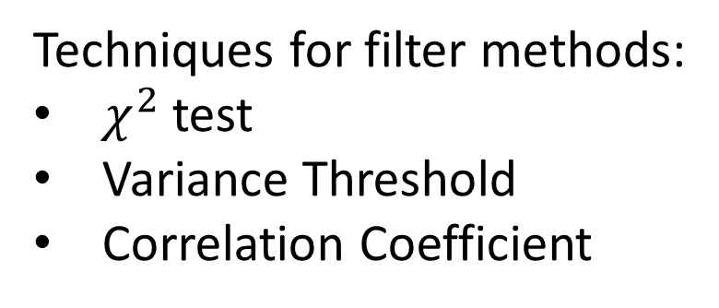
Filter Methods
Set of all features
Selecting the best subset of features
Learning algorithm
Performance improvement
Techniques for filter methods:
$χ^{2}$ test
Variance Threshold
Correlation Coefficient

Slide 41


$χ^{2}$ test
Chi-square method (X2) is generally used to test the relationship between variables. It compares the observed values from different attributes of the dataset to its expected value.
Feature Selection Techniques in Machine Learning - GeeksforGeeks

Slide 42
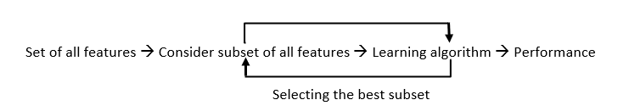
Wrapper-based methods
Wrapper methods, also referred to as greedy algorithms train the algorithm by using a subset of features in an iterative manner.
Based on the conclusions made from training in prior to the model, addition and removal of features takes place.
The main advantage of wrapper methods over the filter methods is that they provide an optimal set of features for training the model, thus resulting in better accuracy than the filter methods but are computationally more expensive.

Slide 43
Wrapper-based methods
Forward selection –
an iterative approach where we initially start with an empty set of features and keep adding a feature which best improves our model after each iteration.
The stopping criterion is till the addition of a new variable does not improve the performance of the model.
Backward elimination –
This method is also an iterative approach where we initially start with all features and after each iteration, we remove the least significant feature.
The stopping criterion is till no improvement in the performance of the model is observed after the feature is removed.
Bi-directional elimination –
This method uses both forward selection and backward elimination technique simultaneously to reach one unique solution.

Slide 44
Wrapper-based methods
Exhaustive selection –
This technique is considered as the brute force approach for the evaluation of feature subsets.
It creates all possible subsets and builds a learning algorithm for each subset and selects the subset whose model’s performance is best.

Slide 45
Sometimes in a real world dataset, all features do not contribute well enough towards ﬁtting a model.
The features that do not contribute signiﬁcantly, can be removed. It leads to decrease in size of the dataset and hence, the computation cost of ﬁtting a model.
sklearn.feature_selection provides many APIs to accomplish this task.
Filter
Wrapper
VarianceThreshold
SelectKBest SelectPercentile GenericUnivariateSelect
RFE
RFECV
SelectFromModel SequentialFeatureSelector
Note: Tree based and kernel based feature selection algorithms will be covered in later weeks.

Slide 46
Filter based feature selection methods

Slide 47
Removing features with low variance
VarianceThreshold
Removes all features with variance below a certain threshold, as speciﬁed by the
user, from input feature matrix
By default removes a feature which has same
value, i.e. zero variance.

Slide 48
Univariate feature selection
In mathematics, a univariate object is an expression, equation, function or polynomial involving only one variable.
Univariate feature selection selects features based on univariate statistical tests.
There are three APIs for univariate feature selection:
SelectKBest
SelectPercentile
Removes all but the
k highest scoring features
Removes all but a user-
speciﬁed highest scoring percentage of features
GenericUnivariateSelect
Performs univariate feature selection with a
conﬁgurable strategy, which can be found via hyper-parameter search.

Slide 49

sklearn provides one more class of univariate feature selection methods that work on common univariate statistical tests for each feature:
SelectFpr selects features based on a false positive rate test.
SelectFdr selects features based on an estimated false discovery rate.
FDR = FP / (FP + TP)
SelectFwe selects features based on family-wise error rate.

Slide 50
Univariate scoring function
Each API need a scoring function to score each feature.
Three classes of scoring functions are proposed:
Mutual information (MI)
Chi-square
F-statistics
MI and F-statistics can be used in both classiﬁcation and regression problems.
mutual_info_regression
f_regression
mutual_info_classif
f_classif
Chi-square can be used only in classiﬁcation problems.
chi2

Slide 51
Mutual information (MI)
Chi-square
Measures dependency
between two variables. It returns a non-negative value.
MI = 0 for independent variables.
Higher MI indicates higher dependency.
Measures dependence
between two variables. Computes chi-square stats between non-negative feature (boolean or frequencies) and class label. Higher chi-square values indicates that the features and labels are likely to be correlated.
MI and chi-squared feature selection is recommended for sparse data.

Slide 52
SelectKBest
skb = SelectKBest(chi2, k=20) X_new = skb.fit_transform(X, y)
Selects 20 best features based on chi-square scoring function.
SelectPercentile
sp = SelectPercentile(chi2, percentile=20) X_new = sp.fit_transform(X, y)
Selects top 20 percentile best features based on chi-square
scoring function.
'percentile' (default), 'k_best',
'fpr', 'fdr', 'fwe'
GenericUnivariateSelect
transformer = GenericUnivariateSelect(chi2, mode='k_best', param=20) X_new = transformer.fit_transform(X, y)
Selects 20 best features based on chi-square scoring function.

Slide 53
GenericUnivariateSelect
transformer = GenericUnivariateSelect(chi2, mode='k_best', param=20) X_new = transformer.fit_transform(X, y)
Selects set of features based on a feature selection mode and a scoring function.
The mode could be 'percentile' (default), 'k_best', 'fpr', 'fdr', 'fwe'.
The param argument takes value corresponding to the mode.

Slide 54
Do not use regression feature scoring function with a classiﬁcation problem. It will lead to useless results.

Slide 55
Wrapper based ﬁlter selection
Unlike ﬁlter based methods, wrapper based
methods use estimator class rather than a scoring function.

Slide 56
Recursive Feature Elimination (RFE)
Uses an estimator to recursively remove features.
Initially ﬁts an estimator on all features.
Obtains feature importance from the estimator and removes the least important feature.
Repeats the process by removing features one by one, until desired number of features are obtained.
Use RFECV if we do not want to specify the desired
number of features in RFE .
It performs RFE in a cross-validation loop to ﬁnd the optimal number of features.

Slide 57
SelectFromModel
Selects desired number of important features (as speciﬁed
with max_features parameter) above certain threshold of feature importance as obtained from the trained estimator.
The feature importance is obtained via coef_,
feature_importances_ or an importance_getter callable from the trained estimator
The feature importance threshold can be speciﬁed either numerically or through string argument based on built-in heuristics such as 'mean', 'median' and ﬂoat multiples of these like '0.1*mean'.
Let's look at a concrete example of SelectFromModel

Slide 58
clf = LinearSVC(C=0.01, penalty="l1", dual=False) clf = clf.fit(X, y)
clf.coef_
model = SelectFromModel(clf, prefit=True) X_new = model.transform(X)
Here we use a linear support vector classiﬁer to get coefﬁcients of features for SelectFromModel transformer. It ends up selecting features with non-zero weights or coefﬁcients.

Slide 59
Sequential feature selection
Performs feature selection by selecting or deselecting
features one by one in a greedy manner.
Uses one of the two approaches
Forward selection
Backward selection
Starting with a zero feature, it ﬁnds
one feature that obtains the best cross validation score for an estimator when trained on that feature.
Starting with all features
and removes least important features one by one following the idea of forward selection.
Repeats the process by adding a new
feature to the set of selected features.
Stops when reach the desired number of features.

Slide 60
The direction parameter controls whether forward or backward SFS is used.
In general, forward and backward selection do not yield equivalent results.
Select the direction that is efﬁcient for the required number of selected features:
When we want to select 7 out of 10 features,
Forward selection would need to perform 7 iterations. Backward selection would only need to perform 3.
Backward selection seems to be a reasonable choice here.

Slide 61
SFS does not require the underlying model to expose a coef_ or
feature_importances_ attributes unlike in RFE and SelectFromModel. SFS may be slower than RFE and SelectFromModel as it needs to evaluate more models compared to the other two approaches.
For example in backward selection, the iteration going from m features to m − 1 features using k-fold cross-validation requires ﬁtting m × k models, while
RFE would require only a single ﬁt, and
SelectFromModel performs a single ﬁt and requires no iterations.

Slide 62
Applying transformations to diverse features

Slide 63
Generally training data contains diverse features such as numeric and categorical.
Different feature types are processed with different transformers.
Need a way to combine different feature transformers seamlessly.

Slide 64
Composite Transformer
sklearn.compose has useful classes and methods to apply transformation on subset of features and combine them:
ColumnTransformer
TransformedTargetRegressor

Slide 65
ColumnTransformer
It applies a set of transformers to columns of an array or
pandas.DataFrame, concatenates the transformed outputs from different transformers into a single matrix.
It is useful for transforming heterogenous data by applying different transformers to separate subsets of features.
It combines different feature selection mechanisms and transformation into a single transformer object.

Slide 66
ColumnTransformer()
Each tuple has format
(estimatorName,estimator(...), columnIndices)
column_trans = ColumnTransformer( [('ageScaler', CountVectorizer(), [0]]),
('genderEncoder', OneHotEncoder(dtype='int'), [1])], remainder='drop', verbose_feature_names_out=False)

Slide 67
Illustration of Column Transformer
Consider following feature matrix, which represent weight and gender of a class of students.
⎡20.0 ‘male′
⎤
11.2 ‘female
′
⎢
⎥
⎢
′
⎥
15.6 ‘female
13.0 ‘male′
18.6 ‘male′
16.4 ‘female
X =
⎢
⎥
6×2
⎢
⎥
⎣
′
⎦
Here, ﬁrst column is numeric, however, second column is categorical, therefore different transformers have to be applied on them.

Slide 68
In this example, lets apply MaxAbsScaler on the numeric column and OneHotEncoder on categorical column.
column_trans = ColumnTransformer( [('ageScaler', MaxAbsScaler(), [0]]),
('genderEncoder', OneHotEncoder(dtype='int'), [1])], remainder='drop', verbose_feature_names_out=False)
column_trans.fit_transform(X)
⎡20.0
‘male′
⎤
⎡ 1. 0. 1.⎤
0.56 1. 0.
0.78 1.
0.65 0.
0.93 0. 0.82 1. 0.
11.2 ‘female
′
⎢
⎥
⎢
⎥
⎢
′
⎥
⎢
⎥
15.6 ‘female
13.0 ‘male′
18.6 ‘male′
16.4 ‘female
_{X}′
0.
1.
1.
X =
⎢
⎥
=
⎢
⎥
6×2
6×3
⎢
⎥
⎢
⎥
⎣
′
⎦
⎣
⎦
60

Slide 69
Transforming Target for Regression
TransformedTargetRegressor
Transforms the target variable y before ﬁtting a regression model.
The predicted values are mapped back to the original space via an inverse transform.
TransformedTargetRegressor takes regressor and transformer to be applied to the target variable as arguments.
import numpy as np
from sklearn.linear_model import LinearRegression from sklearn.compose import TransformedTargetRegressor
tt = TransformedTargetRegressor(regressor=LinearRegression(),
func=np.log, inverse_func=np.exp)
X = np.arange(4).reshape(-1, 1) y = np.exp(2 * X).ravel() tt.fit(X, y)

Slide 70
Part 3: Dimensionality reduction

Slide 71
Another way to reduce the number of feature is through unsupervised dimensionality reduction techniques.
sklearn.decomposition module has a number of APIs for this task.
We will focus on how to perform feature
reduction with principle component analysis (PCA) in sklearn.

Slide 72
PCA 101
PCA, is a linear dimensionality reduction technique.
It uses singular value decomposition (SVD) to project the feature matrix or data to a lower dimensional space. The ﬁrst principle component (PC) is in the direction of maximum variance in the data.
It captures bulk of the variance in the data.
The subsequent PCs are orthogonal to the ﬁrst PC and gradually capture lesser and lesser variance in the data. We can select ﬁrst k PCs such that we are able to capture the desired variance in the data.
sklearn.decomposition.PCA API is used for performing
PCA based dimensionality reduction.

Slide 73
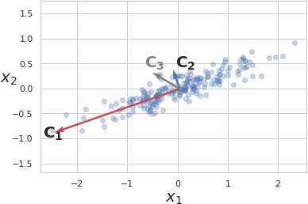
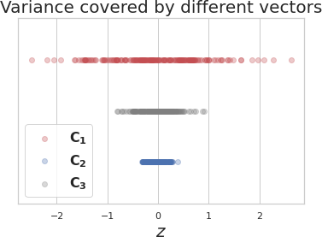
PCA illustration
Blue dots are data points.
x₁ and x₂ are features.
C₁, C₂ and C₃ are candidate PCs.
𝑥 represents projection of data points on a candidate vector.

Slide 74
Out of 3 candidate vectors to project data on, vector C₁ captures
most of the variance, hence it is the ﬁrst PC and C₂, which is orthogonal to it is the second PC

Slide 75
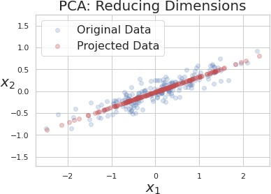
After applying PCA and choosing only ﬁrst PC to reduce dimension of data.

Slide 76
Part 4: Chaining transformers

Slide 77
The preprocessing transformations are applied one after another on the input feature matrix.
si = SimpleImputer()
X_imputed = si.fit_transform(X) ss =StandardScaler()
X_scaled = ss.fit_transform(X_imputed)
It is important to apply exactly same transformation on
training, evaluation and test set in the same order.
Failing to do so would lead to incorrect predictions from model due to distribution shift and hence incorrect performance evaluation.

Slide 78
The sklearn.pipeline module provides utilities to build a composite estimator, as a chain of transformers and estimators.
There are two classes: (i) Pipeline and (ii) FeatureUnion.
Class | Usage
Pipeline | Constructs a chain of multiple transformers to execute a ﬁxed sequence of steps in data preprocessing and modelling.
FeatureUnion | Combines output from several transformer objects by creating a new transformer from them.

Slide 79
sklearn.pipeline.Pipeline
Sequentially apply a list of transformers and estimators.
Intermediate steps of the pipeline must be ‘transformers’ that is, they must implement ﬁt and transform methods.
The ﬁnal estimator only needs to implement ﬁt.
The purpose of the pipeline is to assemble several steps that can be cross-validated together while setting different parameters.

Slide 80
Creating Pipelines
Two ways to create a pipeline object.
Pipeline()
It takes a list of
('estimatorName',
estimator(...)) tuples.
The pipeline object exposes interface of the last step.
estimators = [
('simpleImputer', SimpleImputer()), ('standardScaler', StandardScaler()),
]
pipe = Pipeline(steps=estimators)
make_pipeline
It takes a number of estimator objects only.
pipe = make_pipeline(SimpleImputer(),
StandardScaler())

Slide 81
Without pipeline:
si = SimpleImputer()
X_imputed = si.fit_transform(X) ss =StandardScaler()
X_scaled = ss.fit_transform(X_imputed)
With pipeline:
estimators = [
('simpleImputer', SimpleImputer()), ('standardScaler', StandardScaler()),
]
pipe = Pipeline(steps=estimators) pipe.fit_transform(X)

Slide 82
Accessing individual steps in Pipeline
estimators = [
('simpleImputer', SimpleImputer()), ('pca', PCA()),
('regressor', LinearRegression())
]
pipe = Pipeline(steps=estimators)
Total # steps: 3
SimpleImputer
PCA
LinearRegression
The second estimator can be
accessed in following 4 ways:
pipe.named_steps.pca pipe.steps[1]
pipe[1]
pipe['pca']

Slide 83
Accessing parameters of each step in Pipeline
Parameters of the estimators in the pipeline can be accessed using the <estimator> <parameterName> syntax, note there are two underscores between <estimator> and
<parameterName>
estimators = [
('simpleImputer', SimpleImputer()), ('pca', PCA()),
('regressor', LinearRegression())
]
pipe = Pipeline(steps=estimators)
pipe.set_params(pca n_components = 2)
In above example n_components of PCA() step is set after the
pipeline is created.
75

Slide 84
Performing grid search with pipeline
By using naming convention of nested parameters, grid search can implemented.
param_grid = dict(imputer=['passthrough',
SimpleImputer(), KNNImputer()],
clf=[SVC(), LogisticRegression()], clf C=[0.1, 10, 100])
grid_search = GridSearchCV(pipe, param_grid=param_grid)
C is an inverse of regularization, lower its value stronger the regularization is.
In the example above clf C provides a set of values for grid search.

Slide 85
Caching transformers
Transforming data is a computationally expensive step.
For grid search, transformers need not be applied for every parameter conﬁguration. They can be applied only once, and the transformed data can reused.
This can be achieved by setting memory parameter of a pipeline object.
memory can take either location of a directory in string format or joblib.Memory object.
estimators = [
('simpleImputer', SimpleImputer()), ('pca', PCA(2)),
('regressor', LinearRegression())
]
pipe = Pipeline(steps=estimators, memory = '/path/to/cache/dir')

Slide 86
Advantages of pipeline
Combines multiple steps of end to end ML into single object such as missing value imputation, feature scaling and encoding, model training and cross validation.
Enables joint grid search over parameters of all the estimators in the pipeline.
Makes conﬁguring and tuning end to end ML quick and easy.
Offers convenience, as a developer has to call fit() and
predict() methods only on a Pipeline object (assuming last step in the pipeline is an estimator).
Reduces code duplication: With a Pipeline object, one doesn't have to repeat code for preprocessing and transforming the test data.

Slide 87
sklearn.pipeline.FeatureUnion
Concatenates results of multiple transformer objects. Applies a list of transformer objects in parallel, and their outputs are concatenated side-by-side into a larger matrix.
FeatureUnion and Pipeline can be used to create complex transformers.

Slide 88
Combining Transformers and Pipelines
FeatureUnion() accepts a list of tuples. Each tuple is of the format:
('estimatorName',estimator(...))
num_pipeline = Pipeline([('selector',ColumnTransformer([('select_first_4',
'passthrough', slice(0,4))])),
('imputer', SimpleImputer(strategy="median")), ('std_scaler', StandardScaler()),
])
cat_pipeline = ColumnTransformer([('label_binarizer', LabelBinarizer(),[4]),
])
full_pipeline = FeatureUnion(transformer_list=
[("num_pipeline", num_pipeline), ("cat_pipeline", cat_pipeline),])

Slide 89
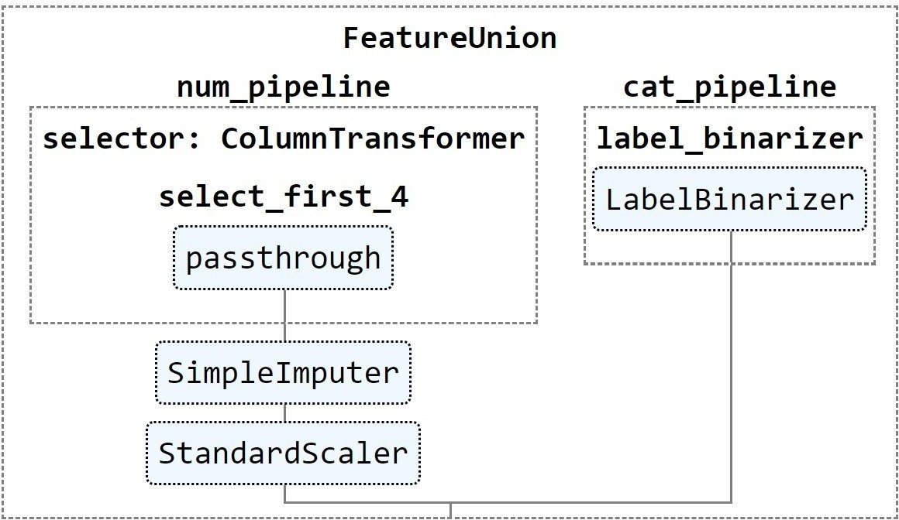
Visualizing Composite Transformers
from sklearn import set_config set_config(display='diagram')
# displays HTML representation in a jupyter context full_pipeline
It creates the following visualization

Slide 90
That's it from data preprocessing.
Only way to master is to practice it with
examples.
Read more about these methods in sklearn
user guide on data transformation and documentation of different classes.

